Slide 1

Introduction to Radix and Shell sort
Data Structure | Searching and Sorting
Course: Data Structure | Chapter: Searching and Sorting | Program: Bachelor of Engineering
DISCOVER · LEARN · EMPOWER
Notes:
Welcome students to Unit-3 of our Data Structure course. Today we dive into two specialized sorting algorithms: Radix and Shell sort. These methods offer unique approaches to organizing data efficiently. Remember, mastering these is key to solving complex engineering problems.

Slide 2
Course Outcomes
SLIDE 2 / 14
Course Outcome
CO | BT LEVEL | DESCRIPTION
CO1 | BT1 | Understand and apply basic data structures, algorithms, complexity analysis, ADTs, arrays and linked lists.
CO2 | BT2 | Apply and implement stacks and queues in problem-solving.
CO3 | BT3 | Analyse and apply searching, sorting, and hashing techniques.
CO4 | BT4 | Construct and apply tree structures and traversal techniques.
CO5 | BT5 | Represent and solve graph problems using DFS, BFS, and graph algorithms.
Chandigarh University
2 / 14
Notes:
This lecture directly addresses our Course Outcomes. CO1 ensures you understand how these algorithms fit into basic data structures and complexity analysis. CO4 connects these sorting techniques to broader structural applications, even though we focus on arrays here. Both outcomes are critical for your engineering foundation.

Slide 3
Learning Objectives
SLIDE 3 / 14
Learning Outcomes
1
Define the fundamental concept of Radix sort and its non-comparative nature.
2
Explain the working principle of Shell sort and its gap sequence strategy.
3
Analyze the time complexity differences between Radix and Shell sort methods.
4
Demonstrate the step-by-step execution of Radix sort on a numerical list.
5
Identify common pitfalls when implementing Shell sort gap sequences in code.
Chandigarh University
3 / 14
Notes:
By the end of this session, you will be able to define both algorithms clearly. You will understand why Radix sort is non-comparative and how Shell sort improves insertion sort. We will walk through a numerical example to see these in action. Finally, we will discuss where students often make mistakes.

Slide 4
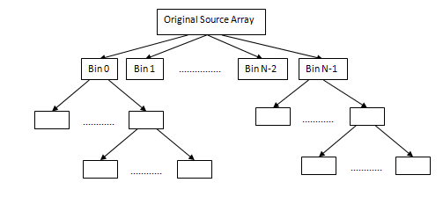
Radix Sort
SLIDE 4 / 14
Non-Comparative Approach
1
Radix sort sorts integers by processing individual digits from least to most significant.
2
It does not compare elements directly, making it faster than comparison-based sorts for specific data.
3
The algorithm relies on a stable sorting subroutine, typically Counting Sort, for each digit.
4
It processes numbers digit by digit, starting from the ones place up to the highest place.
5
The stability of the subroutine ensures that relative order of equal elements is preserved.
6
It is highly efficient for sorting large datasets of fixed-length integers or strings.
7
Time complexity is O(d × (n + b)) where d is digits and b is base.
In-Place N-bit Radix Sort | Algorithm Performance
Chandigarh University
4 / 14
Notes:
Unlike Quick sort, Radix sort does not compare two numbers to decide their order. Instead, it looks at the digits one by one. Imagine sorting a deck of cards by first sorting by suit, then by number. This digit-by-digit approach is the core of its efficiency.

Slide 5
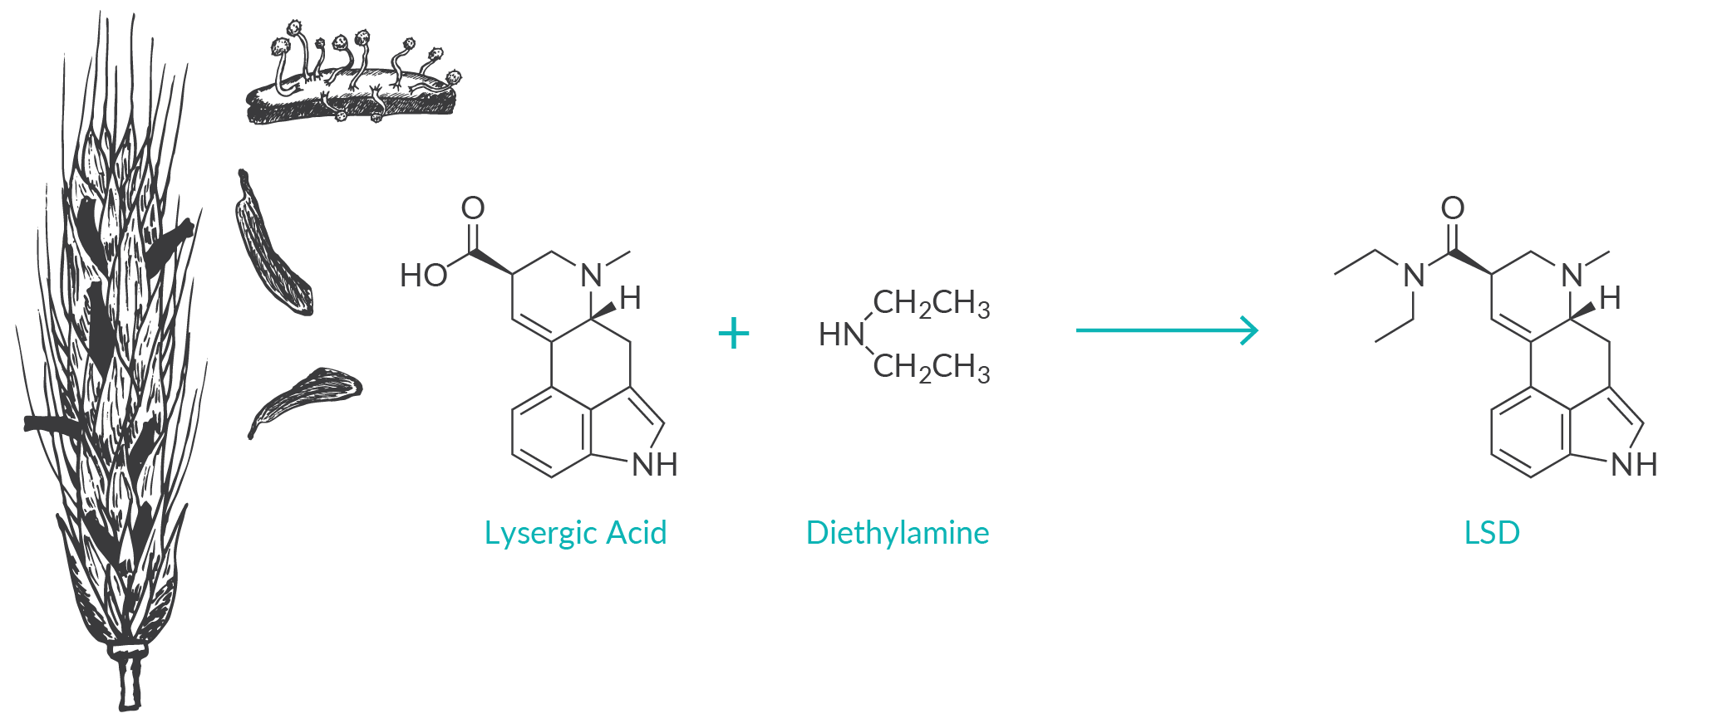
Radix Sort
SLIDE 5 / 14
LSD vs MSD Strategy
1
LSD Radix sort processes digits from the Least Significant Digit to the Most Significant.
2
MSD Radix sort processes digits from the Most Significant Digit to the Least Significant.
3
LSD is generally preferred for fixed-length integers and is easier to implement recursively.
4
MSD is more flexible for variable-length strings but requires more complex logic.
5
LSD requires a stable sort subroutine to maintain the order established by previous passes.
6
The choice between LSD and MSD depends on the specific data characteristics and constraints.
7
LSD is the standard approach taught for integer sorting in introductory data structure courses.
Source: cdn2.caymanchem.com
Chandigarh University
5 / 14
Notes:
There are two main strategies: LSD and MSD. LSD stands for Least Significant Digit, which is what we will focus on today. It starts from the rightmost digit and moves left. This is the most common method for sorting integers because it is straightforward and reliable.

Slide 6
Shell Sort
SLIDE 6 / 14
Generalized Insertion Sort
1
Shell sort is an optimization of the standard Insertion sort algorithm for large lists.
2
It works by sorting elements that are far apart before sorting elements that are close.
3
The algorithm uses a 'gap' sequence to determine which elements to compare and swap.
4
As the gap decreases, the list becomes more sorted, making the final insertion sort fast.
5
It reduces the number of swaps required compared to a standard insertion sort.
6
The efficiency depends heavily on the chosen gap sequence used during the process.
7
It is an in-place sorting algorithm that requires only O(1) extra memory space.
Chandigarh University
6 / 14
Notes:
Think of Shell sort as a smart version of insertion sort. Instead of just comparing neighbors, it compares elements far apart. This moves elements to their approximate correct positions quickly. Once the list is partially sorted, the final pass is very fast.

Slide 7
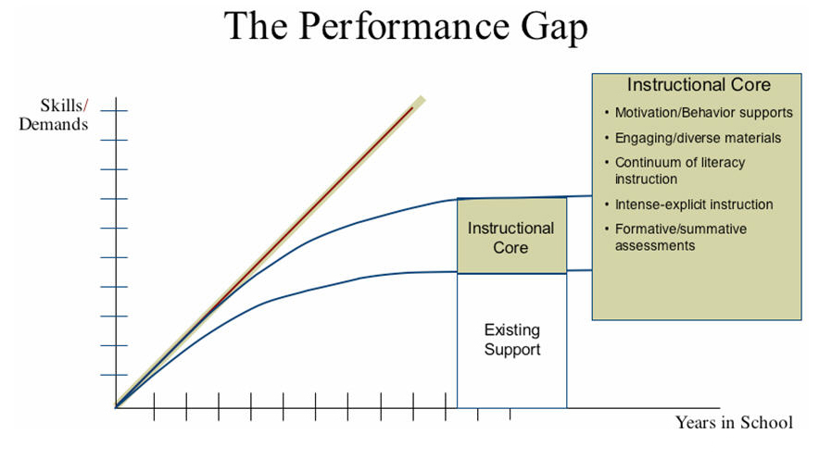
Shell Sort
SLIDE 7 / 14
Gap Sequence Logic
GOVERNING EQUATION
Knuth's sequence (h = 3h + 1) is often recommended for optimal performance
1
The gap sequence determines the distance between elements compared in each pass.
2
Common sequences include Shell's original (n/2), Hibbard's, and Knuth's sequences.
3
A poor gap sequence can result in O(n²) complexity, negating the algorithm's benefits.
4
The gap size is halved or reduced in each iteration until it reaches one.
5
The final pass is a standard insertion sort on a nearly sorted array.
6
The choice of gap sequence is critical for achieving better than O(n²) performance.
Source: www.adlit.org
Chandigarh University
7 / 14
Notes:
The gap sequence is the heart of Shell sort. If you choose a bad sequence, the algorithm might not be much faster than insertion sort. We often use Knuth's sequence, which grows as 1, 4, 13, 40. This ensures a balanced reduction in the gap size.

Slide 8
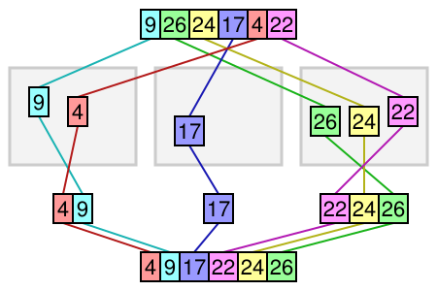
Worked Example
SLIDE 8 / 14
Radix Sort Step 1
CONSIDER THE LIST
[170, 45, 75, 90, 802, 24, 2, 66].
THE LIST AFTER FIRST PASS
[170, 90, 802, 2, 24, 45, 75, 66].
• We start with the Least Significant Digit (ones place) for all numbers.
• We distribute numbers into buckets based on their ones digit (0-9).
• Bucket 0: [170, 90], Bucket 2: [2], Bucket 4: [24], Bucket 5: [45, 75].
• Bucket 6: [66], Bucket 8: [802], Bucket 7: [170, 90] (re-ordered by tens later).
• Collect numbers from buckets in order to form the intermediate list.
Source: www.growingwiththeweb.com
Chandigarh University
8 / 14
Notes:
Let's look at our example list. We start with the ones digit. 170 goes to bucket 0, 45 to bucket 5. We collect them back in order. Notice how 170 and 90 are now together because they both end in 0. This is the first step of the process.

Slide 9
Worked Example
SLIDE 9 / 14
Radix Sort Step 2
THE LIST AFTER SECOND PASS
[170, 90, 802, 2, 24, 45, 75, 66].
• Now we process the tens digit for the intermediate list from the previous step.
• Numbers are redistributed into buckets based on their tens digit (0-9).
• Bucket 0: [170, 90], Bucket 2: [2, 24], Bucket 4: [45], Bucket 6: [66].
• Bucket 7: [75], Bucket 8: [802], Bucket 0: [170, 90] (re-ordered by hundreds later).
• Collect numbers from buckets to form the new intermediate list.
• This process repeats for the hundreds digit to complete the sort.
Chandigarh University
9 / 14
Notes:
Next, we look at the tens digit. 170 has a 7, so it goes to bucket 7. 90 has a 9, so it goes to bucket 9. We collect them again. This step refines the order. We repeat this for every digit until the most significant digit is processed.

Slide 10

Worked Example
SLIDE 10 / 14
Radix Sort Final
FINAL RESULT
[2, 24, 45, 66, 75, 90, 170, 802].
• Finally, we process the hundreds digit for the list from the previous step.
• Bucket 0: [2, 24, 45, 66, 75, 90], Bucket 1: [170], Bucket 8: [802].
• Collecting from buckets yields the fully sorted list.
• The algorithm terminates when the most significant digit has been processed.
• The list is now completely sorted in ascending order.
• Total passes required equals the number of digits in the largest number.
Source: static.vecteezy.com
Chandigarh University
10 / 14
Notes:
After processing the hundreds digit, we get our final sorted list. The numbers are now in perfect order. This demonstrates how Radix sort works. It takes three passes because our largest number, 802, has three digits. Each pass refines the order further.

Slide 11
Worked Example
SLIDE 11 / 14
Shell Sort Step 1
GOVERNING EQUATION
We choose an initial gap, for example, gap = 4 (half the list size)
CONSIDER THE LIST
[23, 12, 1, 8, 34, 54, 2, 3].
• We compare and swap elements that are 4 positions apart.
• Compare 23 and 34 (no swap), 12 and 54 (no swap), 1 and 2 (no swap).
• Compare 8 and 3 (swap), resulting in list: [23, 12, 1, 3, 34, 54, 2, 8].
• This step moves elements closer to their final positions.
• The gap is then reduced for the next iteration.
Chandigarh University
11 / 14
Notes:
Let's try Shell sort on our list. We start with a gap of 4. We compare the first element with the fifth. 23 and 34 are in order. But 8 and 3 are not. We swap them. This moves smaller elements to the left faster than insertion sort.

Slide 12
Worked Example
SLIDE 12 / 14
Shell Sort Step 2
LIST BECOMES
[1, 3, 23, 12, 34, 54, 2, 8].
• Reduce the gap to 2 for the next iteration.
• Compare elements 2 positions apart: 23 and 1 (swap), 12 and 3 (swap).
• Continue comparing and swapping with gap 2 until no more swaps are needed.
• The list is now significantly more sorted than the initial state.
• The final pass will use a gap of 1, which is standard insertion sort.
• This final pass will be very fast because the list is nearly sorted.
Chandigarh University
12 / 14
Notes:
Now we reduce the gap to 2. We compare 23 and 1, swap them. We compare 12 and 3, swap them. The list is getting much closer to sorted. The final pass with a gap of 1 will just be a quick insertion sort because the list is almost ready.

Slide 13
Lecture
SLIDE 13 / 14
Key Takeaways
1
Radix sort is a non-comparative algorithm that sorts by processing digits individually.
2
Shell sort is an optimized insertion sort that uses a gap sequence to improve speed.
3
Radix sort has linear time complexity O(d × (n + b)) for fixed-length integers.
4
Shell sort performance depends critically on the chosen gap sequence.
5
Both algorithms are essential tools for handling specific data sorting challenges efficiently.
Chandigarh University
13 / 14
Notes:
To summarize, Radix sort is unique because it doesn't compare elements. Shell sort is a smart version of insertion sort. Both are powerful tools. Remember that the gap sequence in Shell sort is crucial for its performance. These concepts are fundamental for your data structure knowledge.

Slide 14
Lecture
SLIDE 14 / 14
References
DATA STRUCTURES
A Pseudocode Approach with C — Gilberg, Forouzan
• Data Structures — Lipschutz
• Data Structure Using C — AK Sharma
• C and Data structure — P. S. Deshpandey
Chandigarh University
14 / 14
Notes:
These are the primary textbooks for our course. Please refer to Gilberg and Forouzan for pseudocode approaches. Lipschutz provides excellent theoretical foundations. Sharma and Deshpandey offer practical C implementations. Use these resources to deepen your understanding of these algorithms.

